Slide 1
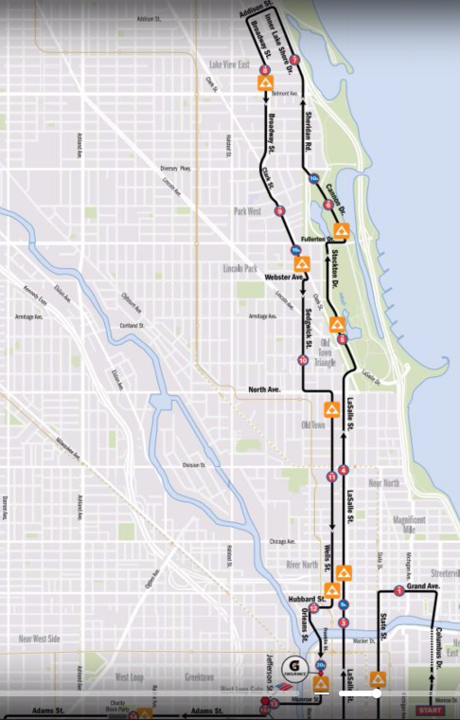
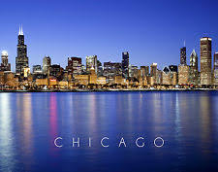
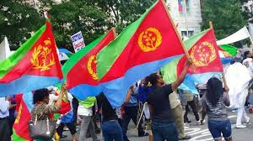
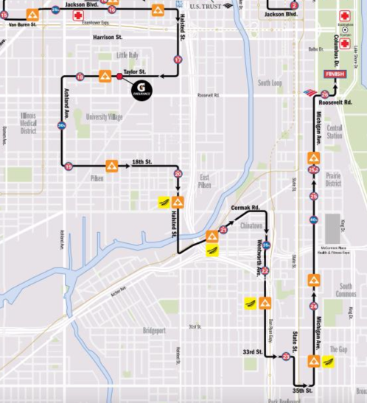
Come all to celebrate and support our own Zersenay Tadese this Sunday October 8, 2017 Event: 40th Anniversary Bank of America Chicago Marathon Place: Starts at Monroe and Columbus goes north to Addison and south to 35th street (check map) Time: starts early morning to about 4:00PM It is advised to be in two to three groups with your flag on the air blowing in different locations through the event key location points and shout it out. HOPE TO SEE YOU ALL
Start
Finish

